Slide 1
Tom-vs-Pete Classifiers and Identity-Preserving Alignment for Face Verification
Thomas Berg
Peter N. Belhumeur
Columbia University

Slide 2


















































How can we tell people apart?
Notes:
The question underlying face verification

Slide 3
















































We can tell people apart using attributes
blond
no beard
female
dark-haired
beard
male
Attributes can be used for face verification
Kumar et al., “Attribute and Simile Classifiers for Face Verification”, ICCV 2009
Notes:
Attributes separate the space. Many ➔ identification and verification.

Slide 4
Limitations of attributes
Finding good attributes is manual and ad hoc
Each attribute requires labeling effort
  Labelers disagree on many attributes
Discriminative features may not be nameable
Instead: automatically find a large number of discriminative features based only on identity labels

Slide 5


How can we tell these two people apart?
Orlando Bloom
Lucille Ball

Slide 6





















Orlando-vs-Lucy classifier
red hair
brown hair
Notes:
Orlando-vs-Lucy classifier.

Slide 7


How can we tell these two people apart?
Stephen Fry
Brad Pitt

Slide 8
























Steve-vs-Brad classifier
straight nose
crooked nose
Notes:
Steve-vs-Brad

Slide 9

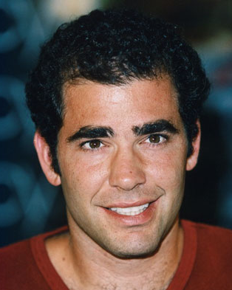
How can we tell these two people apart?
Tom Cruise
Pete Sampras

Slide 10





















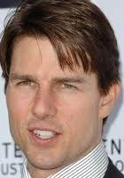






Tom-vs-Pete classifier
?
?
Notes:
We’re going to train a lot of this type of classifier. Call them Tom-vs-Pete.

Slide 11
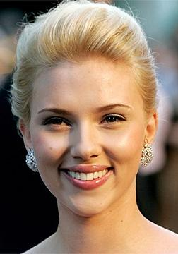
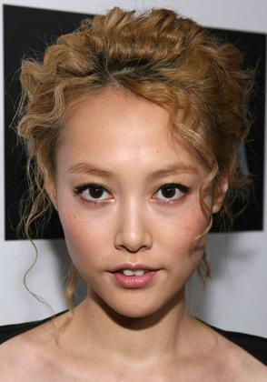
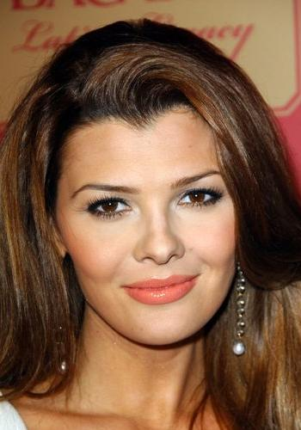
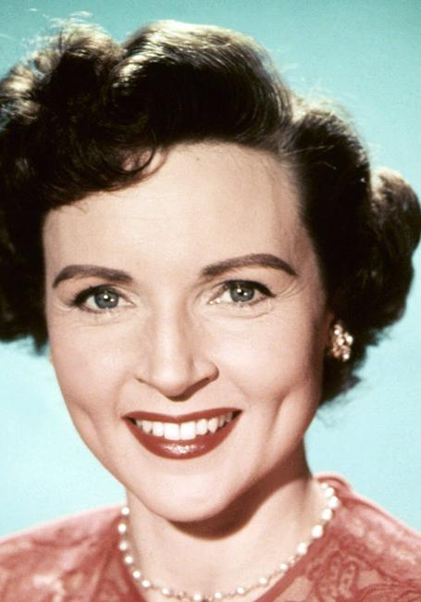
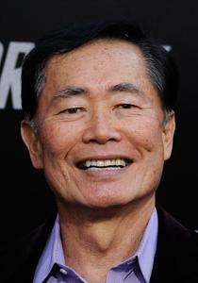
Tom-vs-Pete classifiers generalize
Scarlett
Rinko
Ali
Betty
George
-1
0
1

Slide 12
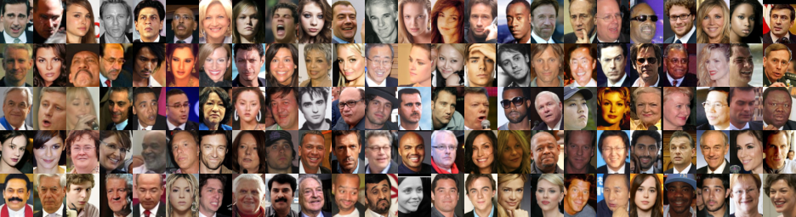












A library of Tom-vs-Pete classifiers
Reference Dataset
  N = 120 people
  20,639 images
k = 11 Image Features: SIFT at landmarks
$k\left(\begin{matrix}N \\ 2\end{matrix}\right)=78,540$ possible Tom-vs-Pete classifiers (linear SVMs)

Slide 13












How can we tell any two people apart?
...
same-or-different classifier
“different”
...
vs
vs
vs
vs
vs
...
Subset of Tom-vs-Pete classifiers
Notes:
That’s the system. Now more detail on how to build classifiers and especially: alignment.

Slide 14
Tom-vs-Pete classifiers see only a small part of the face
Pro:
  More variety of classifier
  Better generalization to novel subjects
Con:
  Require very good alignment
Our alignment is based on face part detection.

Slide 15
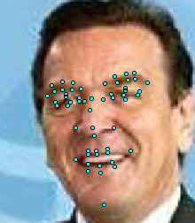
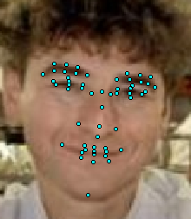
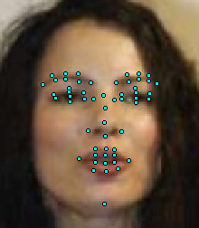
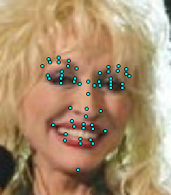

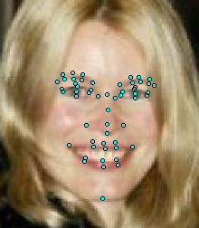
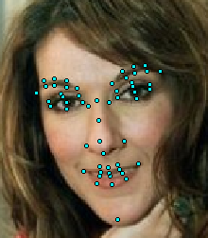
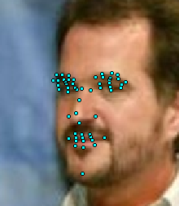
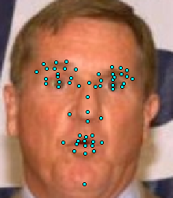
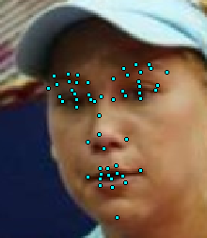
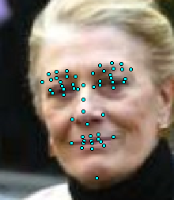
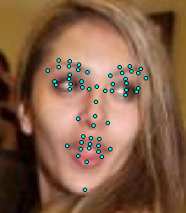
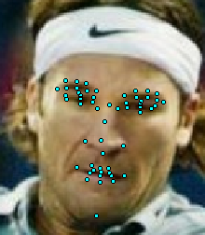
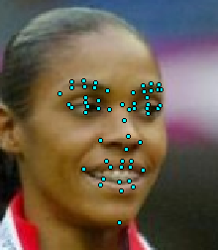
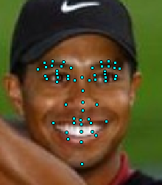
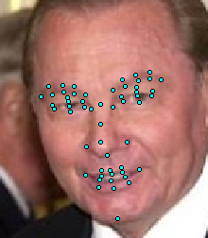
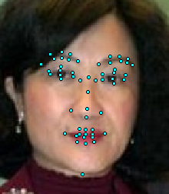
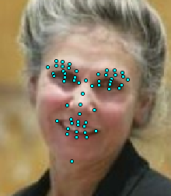
Face part detection
Belhumeur et al., “Localizing Parts of Faces Using a Consensus of Exemplars,” CVPR 2011

Slide 16

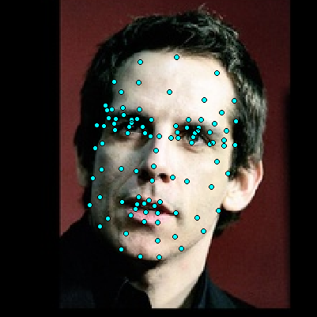
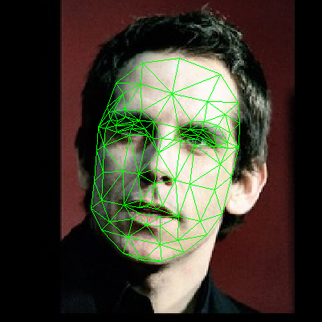
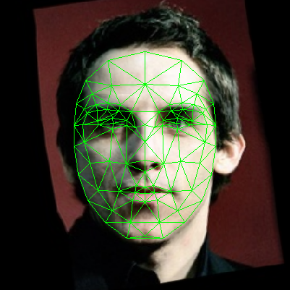


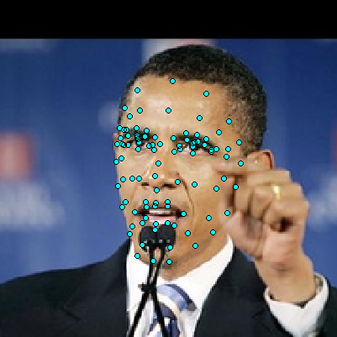
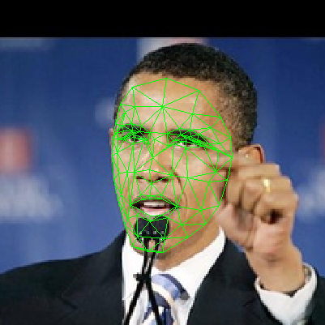
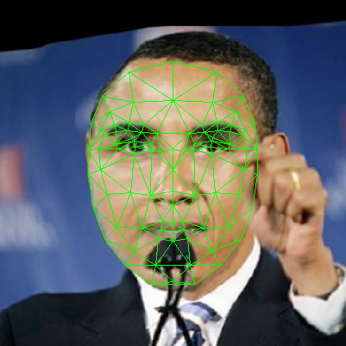
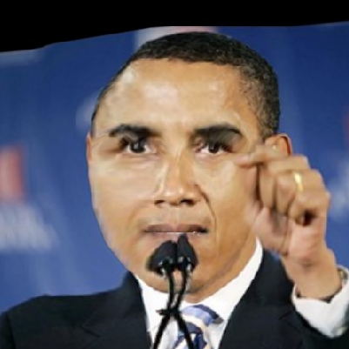
Alignment by piecewise affine warp
Detect parts
Construct triangulation
Affine warp each triangle
+
Corrects pose and expression
_
“Corrects” identity

Slide 17
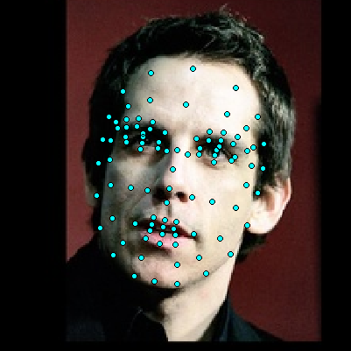

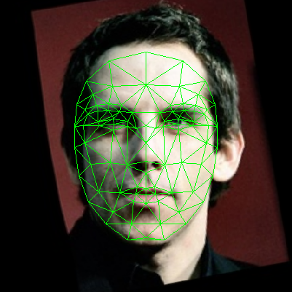



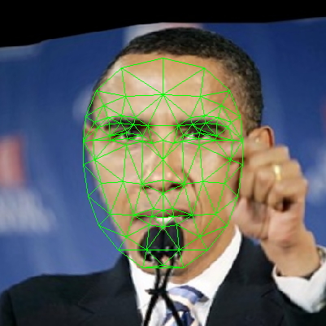

Identity-preserving alignment
Detect parts
Estimate generic parts
Construct triangulation
Affine warp each triangle
Generic Parts: Part locations for an average person with the same pose and expression
Notes:
Now two things: 1. How do generic parts preserve identity? 2. How do we get the generic part locations?

Slide 18




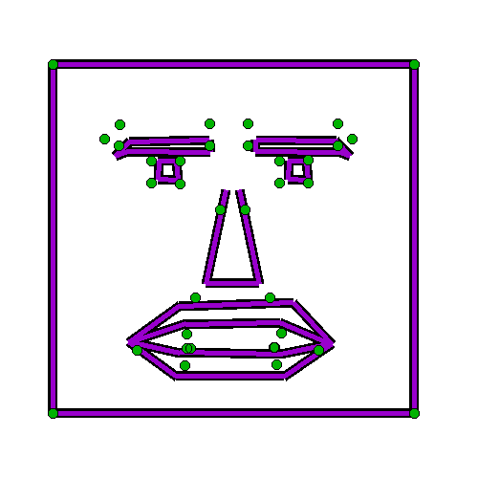
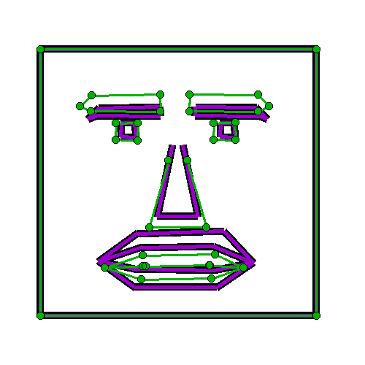





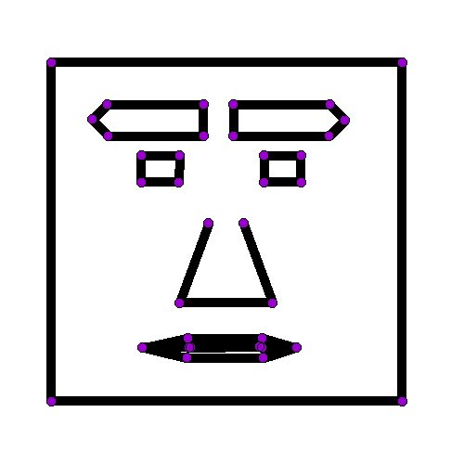



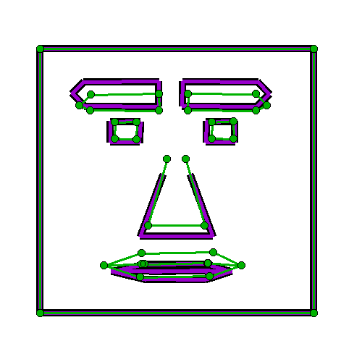


PAW discards identity information
detected parts
canonical parts
move detected parts to canonical parts

Slide 19
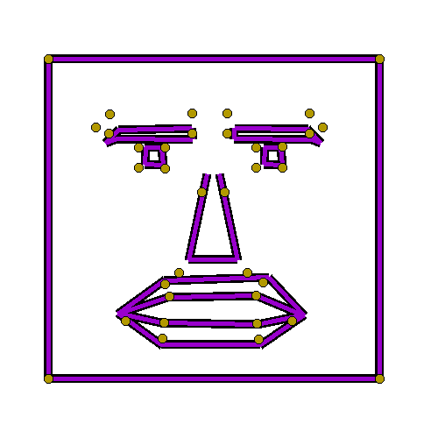
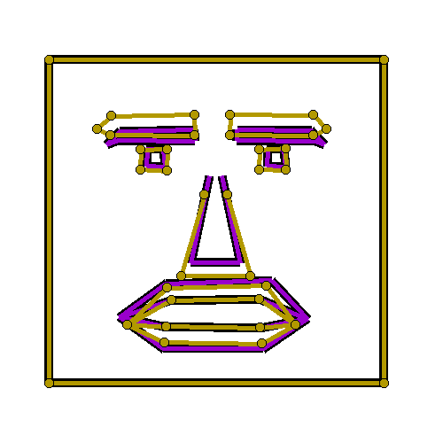


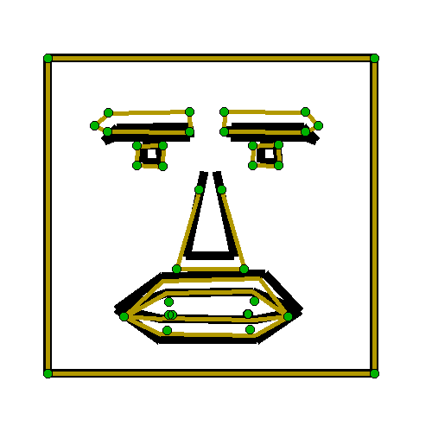
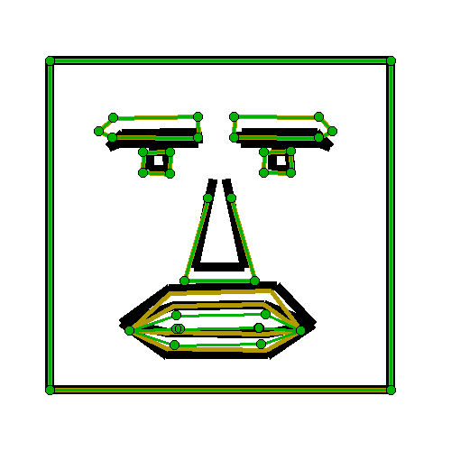




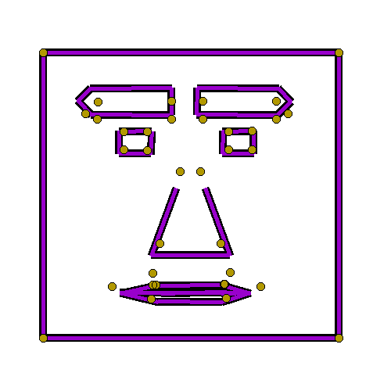
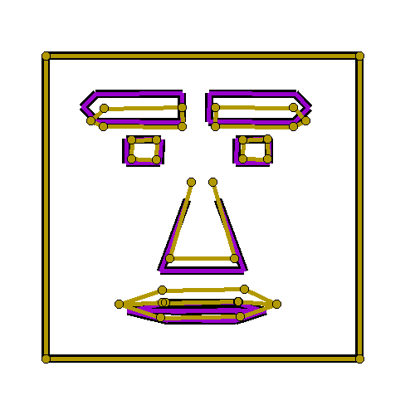
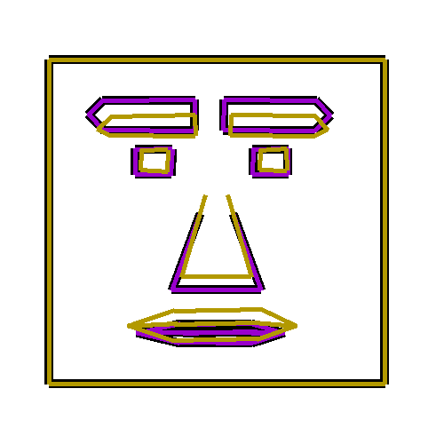

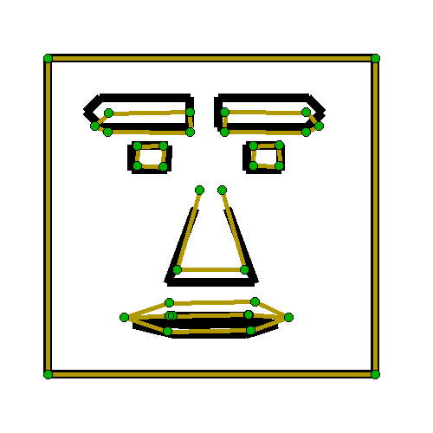





Generic parts preserve identity
detected parts
generic parts
canonical parts
move generic parts to canonical parts

Slide 20
Effect of Identity-preserving alignment
Original
Piecewise Affine
Identity-preserving

Slide 21
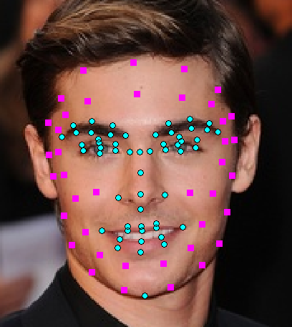
Reference dataset for face parts
Reference Dataset
  N = 120 people
  20,639 images
  95 part labels on every image
Inner parts: Well-defined, detectable
Outer parts: Less well-defined. Inherit from nearest labeled example

Slide 22

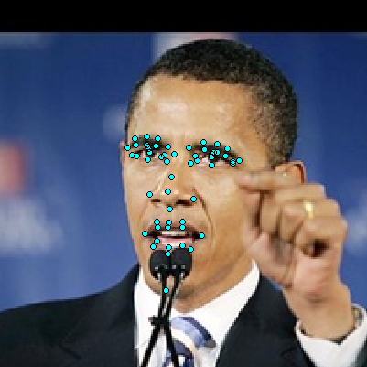

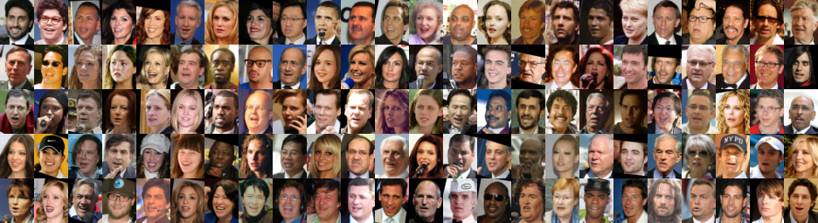

Estimating generic parts
Detect inner parts
Find closest match for each reference subject
$$≈$$
Take mean of (inner & outer) parts on closest matches

Slide 23


Verification system
...
same-or-different classifier
“different”
...
vs
vs
vs
vs
vs
...
Subset of Tom-vs-Pete classifiers

Slide 24








Evaluation: Labeled Faces in the Wild
3000 “same” pairs
3000 “different” pairs
10-fold cross validation
Huang et al., “Labeled Faces in the Wild: A Database for Studying Face Recognition in
Unconstrained Environments,” UMass TR 07-49, October 2007

Slide 25
Results on LFW
Cosine Similarity Metric Learning (CSML) (Nguyen and Bai, ACCV 2010) | 88.00%
Brain-Inspired Features (Pinto and Cox, FG 2011) | 88.13%
Associate-Predict (Yin, Tang, and Sun, CVPR 2011) | 90.57%
Cosine Similarity Metric Learning (CSML) (Nguyen and Bai, ACCV 2010) | 88.00%
Brain-Inspired Features (Pinto and Cox, FG 2011) | 88.13%
Associate-Predict (Yin, Tang, and Sun, CVPR 2011) | 90.57%
Tom-vs-Pete Classifiers | 93.10%
27% reduction of errors

Slide 26

Results on LFW

Slide 27

Results on LFW

Slide 28
Thank you.
Questions?

Slide 29

Contribution of Tom-vs-Pete classifiers

Slide 30

Contribution of identity-preserving warp

