Slide 1
How do you tell a blackbird from a crow?
Thomas Berg
Peter N. Belhumeur
Columbia University

Slide 2
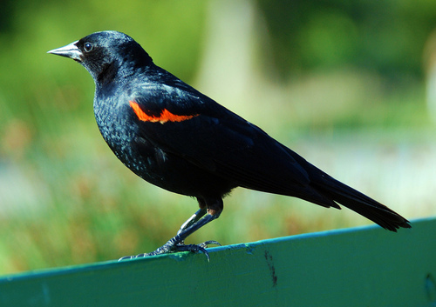
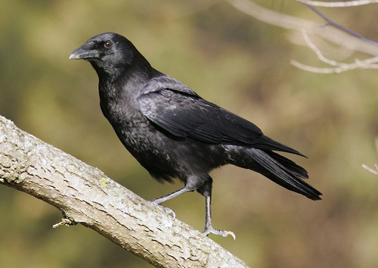
How do you tell a blackbird from a crow?

Slide 3
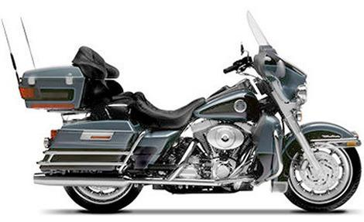
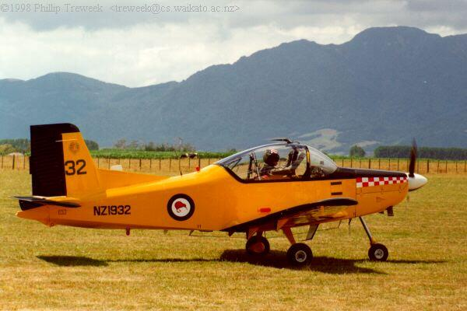
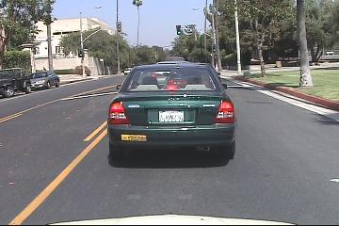
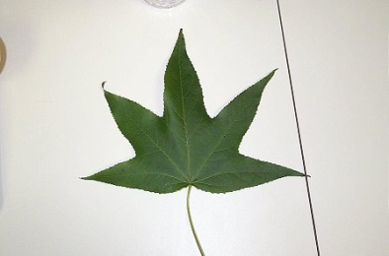

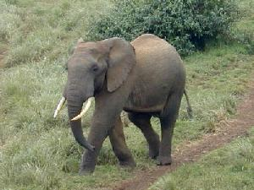

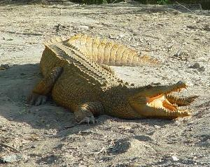

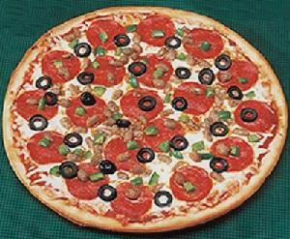
There’s a lot of work on recognition.
Caltech Categories (5 categories)
Caltech-101

Slide 4
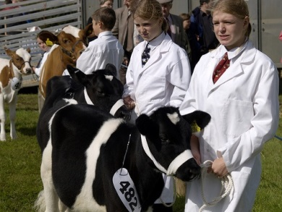

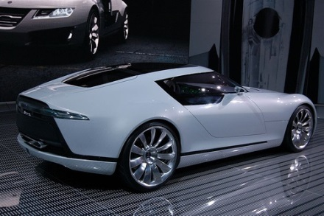
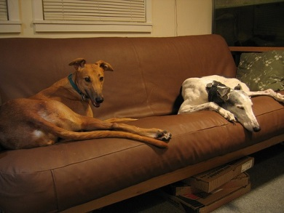
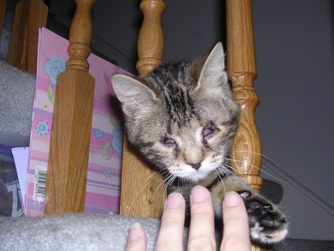
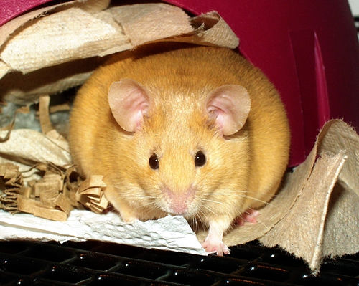
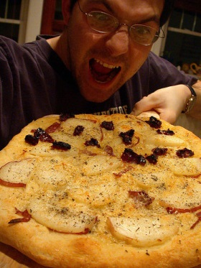

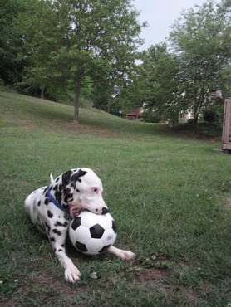
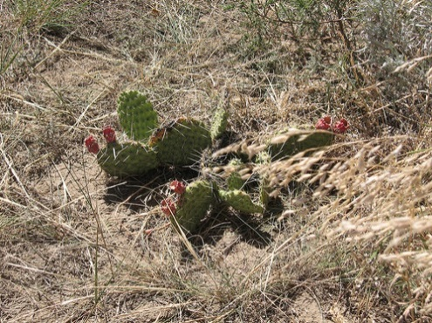
There’s a lot of work on recognition.
PASCAL VOC (20 classes, less controlled)
ImageNet (1000 classes in challenge set)

Slide 5
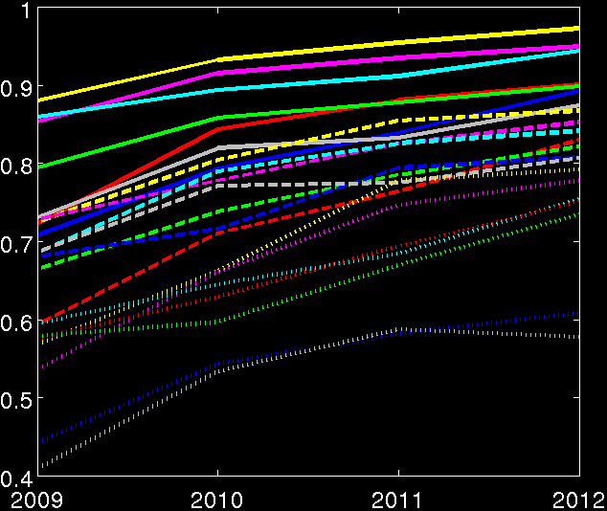
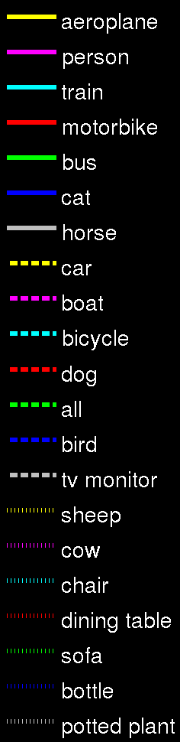
There’s a lot of progress on recognition.
Average Precision
Year
PASCAL VOC Classification Challenge

Slide 6
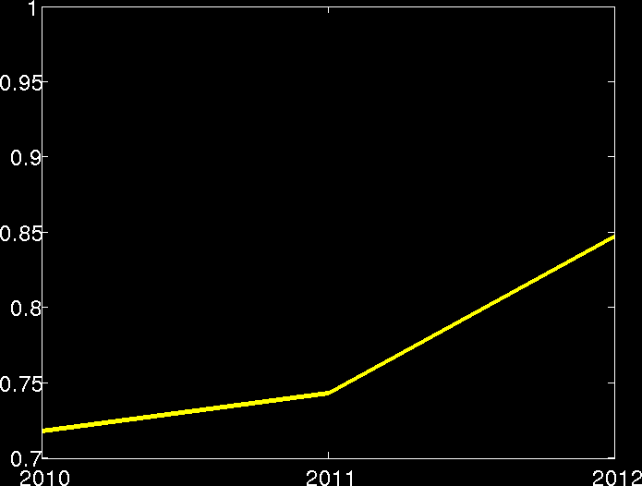
There’s a lot of progress on recognition.
Accuracy (5 predictions)
Year
ImageNet Large Scale Visual Recognition Challenge: Classification

Slide 7






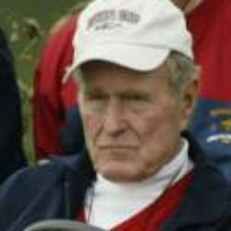


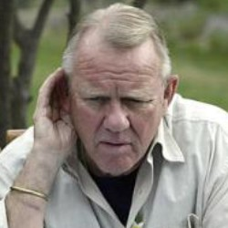
There’s a lot of work on face recognition.
Yale Faces (15 subjects)
Labeled Faces in the Wild (5749 subjects, less controlled)

Slide 8
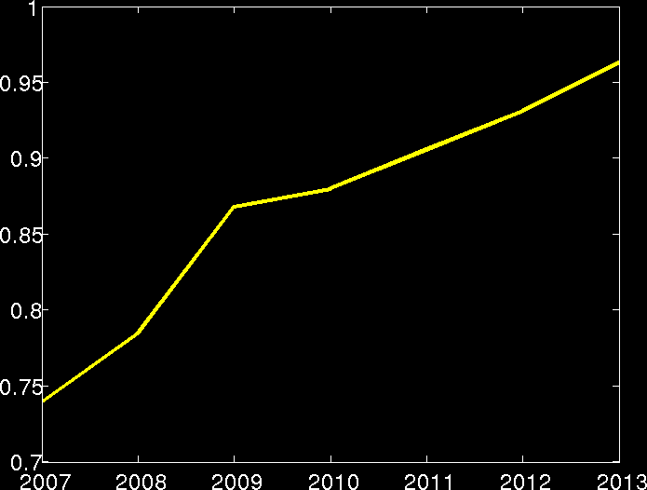
There’s a lot of progress on recognition.
Accuracy
Year
Labeled Faces in the Wild: Image-Restricted Benchmark

Slide 9
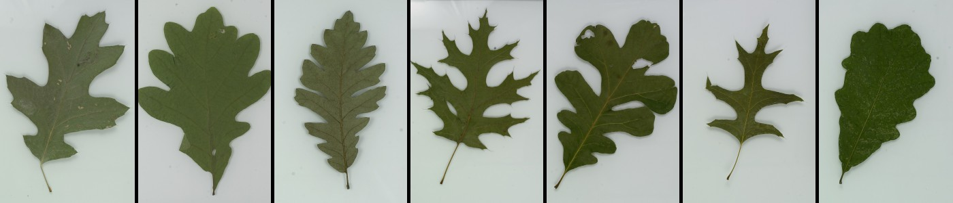
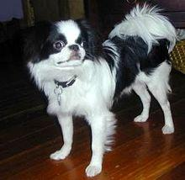
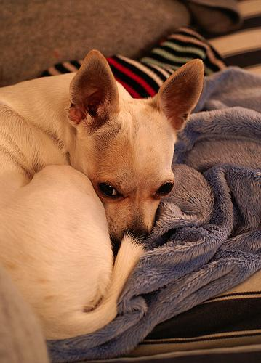

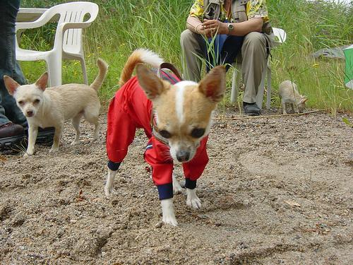
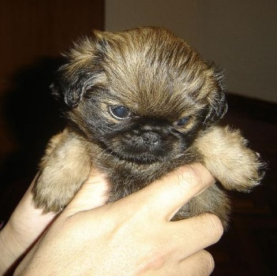
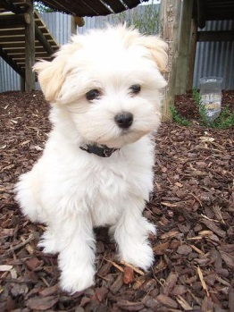
Fine-grained visual categorization.
Leafsnap (184 species)
Stanford Dogs (120 species)

Slide 10
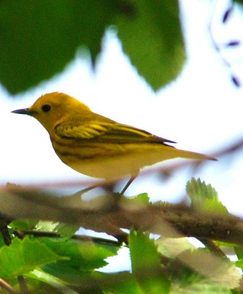
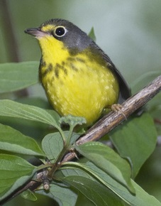
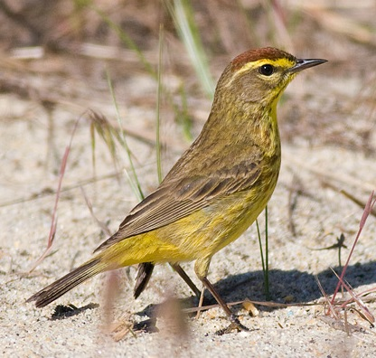
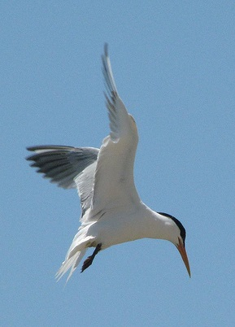
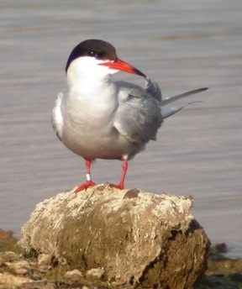
Fine-grained visual categorization.
Caltech-UCSD Birds (200 species)

Slide 11
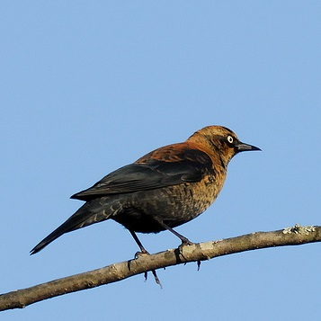
What bird is this?
Rusty Blackbird

Slide 12
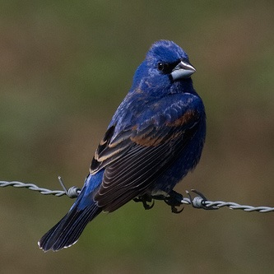
What bird is this?
Blue Grosbeak

Slide 13
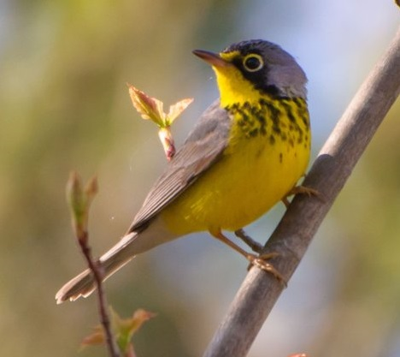
What bird is this?

Slide 14
Fine-grained recognition is difficult for humans.
Can computers teach us to be better?

Slide 15
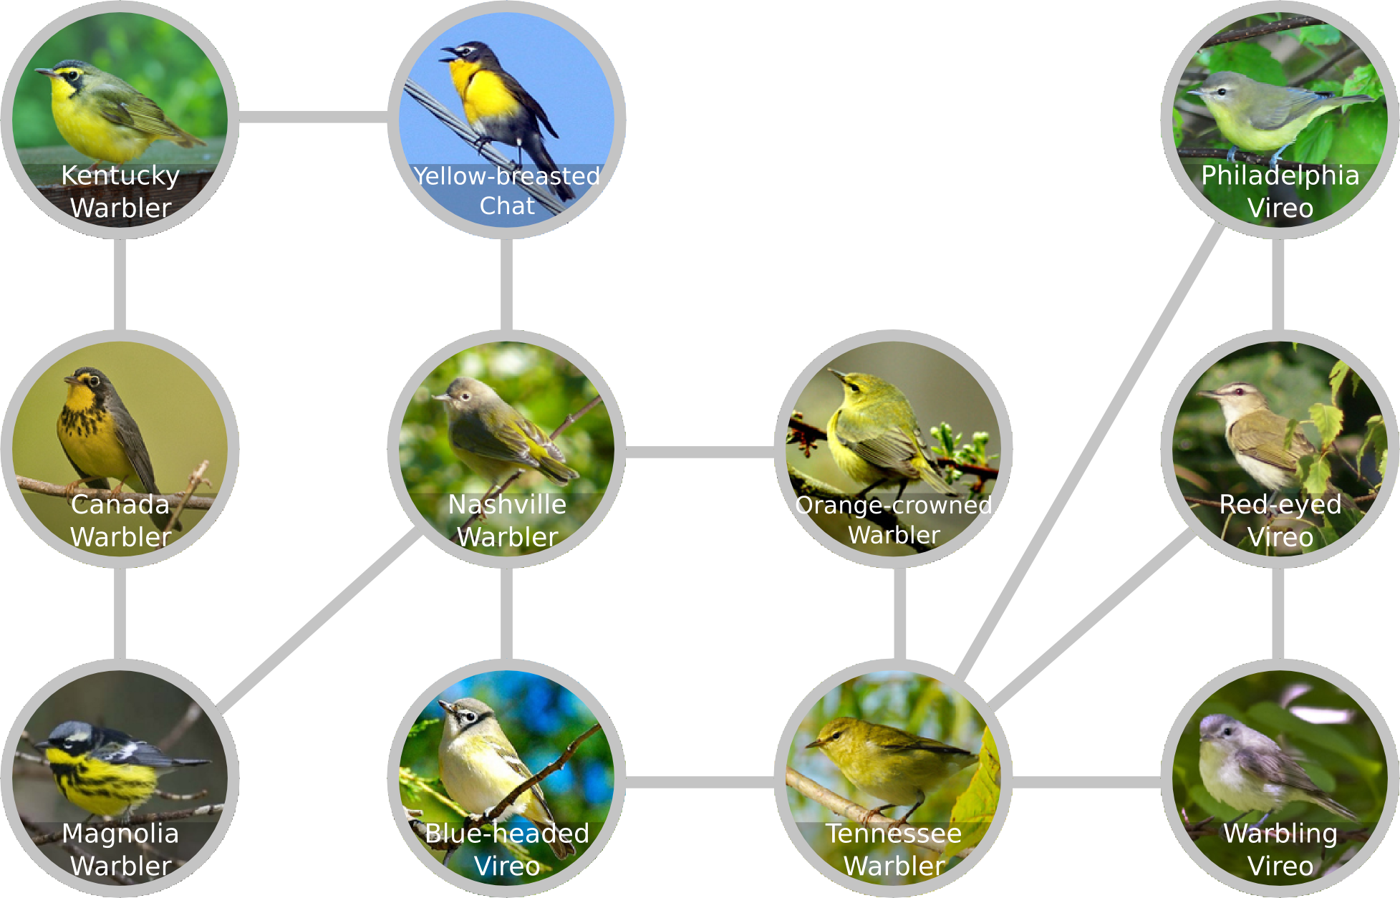
Goal: Build an understanding of a visual domain.
Which classes are most similar to each other?

Slide 16
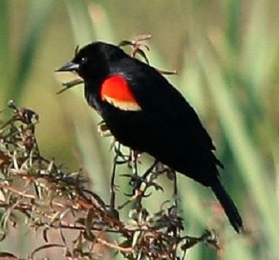
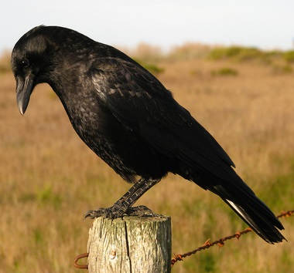
Goal: Build an understanding of a visual domain.
Which classes are most similar to each other?
What distinguishes classes from each other?
Red-winged Blackbird
American Crow

Slide 17
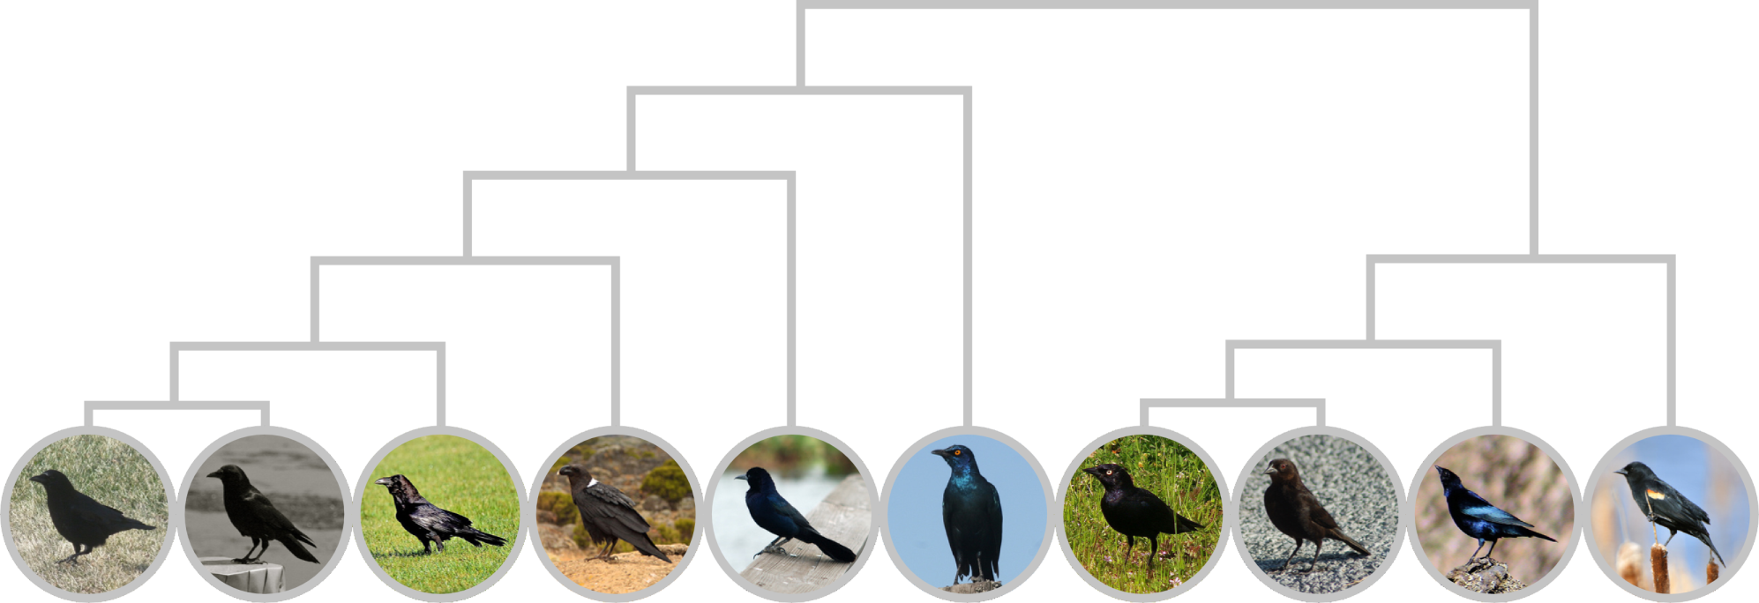
Goal: Build an understanding of a visual domain.
Which classes are most similar to each other?
What distinguishes classes from each other?
Is there a structure (hierarchy) of classes?
Crows, Ravens, and Grackles
Cowbirds and Blackbirds

Slide 18
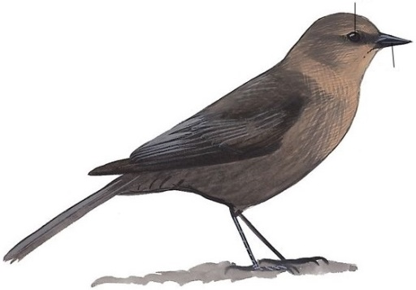
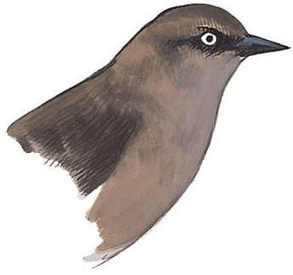
Field guides describe similarities and differences.
Brewer’s Blackbird
Slender and long-tailed. Distinguished from cowbirds by thinner bill, long tail, long legs, and dark-edged primaries.
Adult ♀
dark eye
short, straight bill
occasional ♀ has pale eye
From The Sibley Guide to Birds

Slide 19
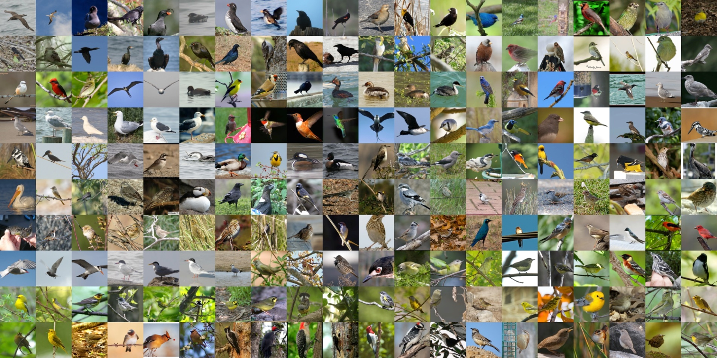
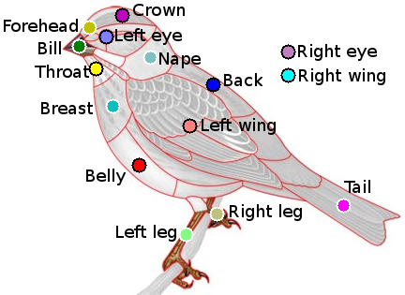
Let’s build a field guide, automatically.
(Given a dataset of images with species and part labels)
The CUB-200-2011 dataset.

Slide 20
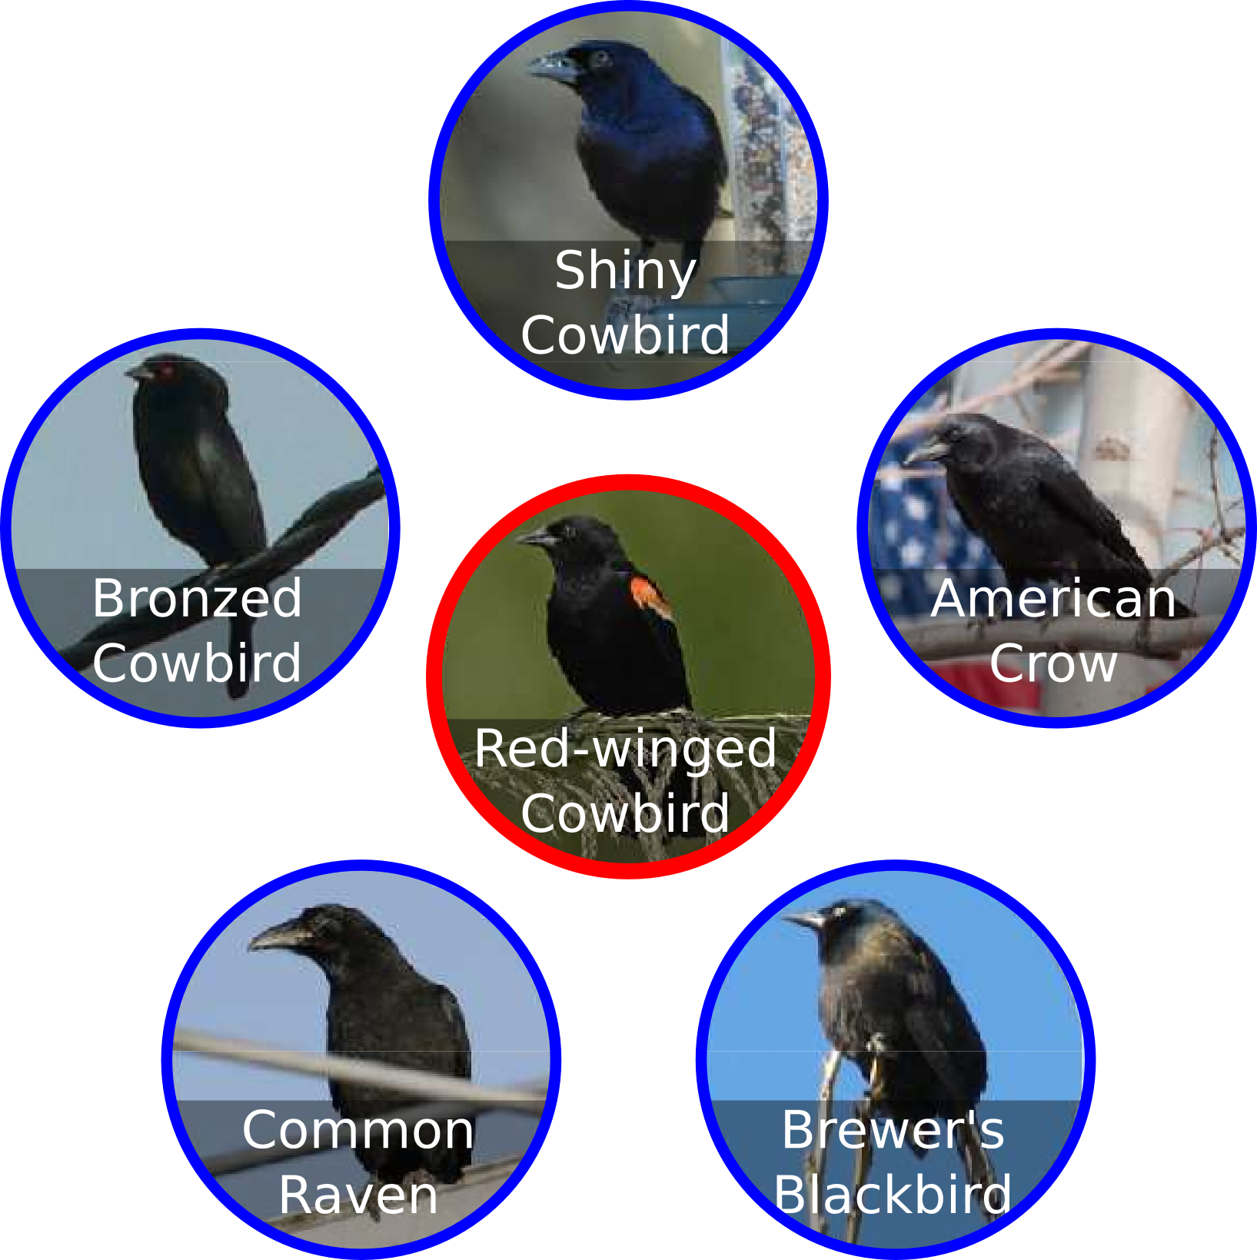
Our field guide entry for the Red-winged Blackbird.
Species similar to the Red-winged Blackbird (Agelaius phoeniceus)

Slide 21
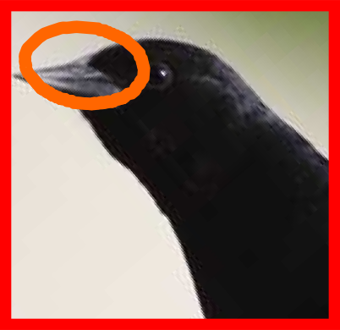
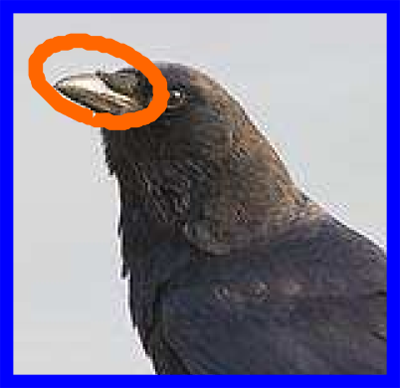
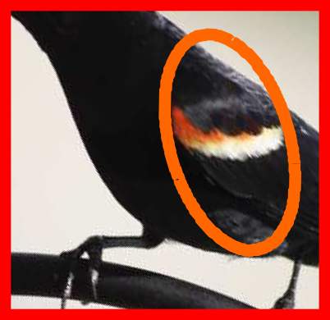
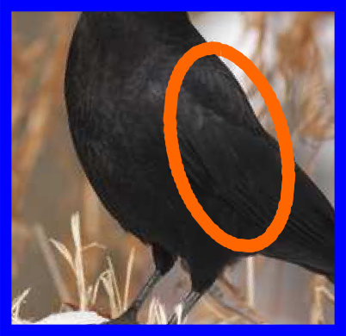
Our field guide entry for the Red-winged Blackbird.
Distinguishing the Red-winged Blackbird from the American Crow:
Red-winged Blackbird
American Crow

Slide 22



We need a feature space.
Discriminative
Part-based
High-level
Part-based One-vs-One Features (POOFs)
vs
Common Tern
Louisiana Waterthrush
Discrimination Map
(CVPR 2013)

Slide 23

































Choose two species
common tern
Louisiana waterthrush

Slide 24


Choose two parts

Slide 25


Align and crop

Slide 26
































































































































Align and crop
Low-level features: HOG
Low-level features: HOG, color histogram grid

Slide 27
Train SVM
Like Louisiana thrush
Like common tern

Slide 28


Evaluate POOF score
Like Louisiana thrush
Like common tern
score

Slide 29
The field guide shows similar species.
Species similar to the Red-winged Blackbird (Agelaius phoeniceus)

Slide 30

Visual similarity approximates phylogenetic similarity.
similar
different
Years since most recent common ancestor.

Slide 31

Estimate similarity by difficulty of discrimination.
similar
different
Confusion matrix

Slide 32

Estimate similarity by difficulty of discrimination.
similar
different
L1 distance between mean POOF vectors

Slide 33

Estimate similarity by difficulty of discrimination.
similar
different
L1 distance after LDA on mean POOF vectors

Slide 34











Visual similarity approximates phylogenetic similarity.
Waterbirds
Crows & Ravens
Passerines
Blackbirds & Cowbirds
Visual Similarity
Phylogenetic Similarity

Slide 35
Show the most similar species to each species.
Species similar to the Red-winged Blackbird (Agelaius phoeniceus)

Slide 36
Our field guide entry for the Red-winged Blackbird.
Distinguishing the Red-winged Blackbird from the American Crow:
Red-winged Blackbird
American Crow

Slide 37



Choose the most discriminative features.

Slide 38


Chose image pairs that illustrate the difference.
…
…
Strong positive and negative POOF scores
Similar scores for other POOFs
Similar pose

Slide 39
I saw a bird… What is it?

Slide 40

Field guides are indexed by taxonomy.
From The Sibley Guide to Birds

Slide 41




Field guides are indexed by the Tree of Life.

Slide 42

The tree of life is based on similarity.
Neighbor-joining method
Saitou and Nei, “The Neighbor-Joining Method: A New Method for Reconstructing Phylogenetic Trees,” Molecular Biology and Evolution, 4(4), 1987

Slide 43

We build a tree of visual similarity.
Neighbor-joining method
Saitou and Nei, “The Neighbor-Joining Method: A New Method for Reconstructing Phylogenetic Trees,” Molecular Biology and Evolution, 4(4), 1987

Slide 44

Some similar species are not closely related.
Phylogenetic Tree

Slide 45

The visual similarity tree enables quick search.
Similarity Tree

Slide 46







Scroll through the tree of similarity.
?
Scott Oriole
Baltimore Oriole
Hooded Oriole
Orange-crowned Warbler
Magnolia Warbler

Slide 47

Navigate the similarity graph to refine search.
?

Slide 48

Navigate the similarity graph to refine search.
?

Slide 49




Look at differences to confirm class.
Canada Warbler
Magnolia Warbler
Canada Warbler
?

Slide 50
Thank you.

Slide 51

Equations (Windows only)
$$d_{f}=\frac{{\left(μ_{1}−μ_{2}\right)}^{2}}{σ_{1}σ_{2}}$$

